Slide 1
SA 330: Animal Husbandry
Joseph Simbaya, Ph.D.
Lusaka – Zambia.

Slide 2
Introduction to Animal Husbandry
What is animal husbandry?
All the answers are partially or fully correct, the fact is that this is the science or art of keeping domestic animals for food,fibre or entatainment to meet human needs.
The food is mostly generated as a source of protein including meat, milk and eggs. The meat is mostly in terms of beef, mutton, pork from animals like cattle, goats, sheep, pigs and a variety of poultry species.
What type of animals do people keep in your area and what are the main products?

Slide 3
Introduction ….
What are the key enterprises arising from keeping different types of domestic animals?
The different types of domestic animals may be divided into different categories including ruminants and non-ruminants
  Cattle could be dairy or beef breeds
  Pigs
  Small ruminants comprises of goats and sheep
  Poultry species include chickens, turkeys, ducks and others
    Broilers
    Layers
    Tukeys, ducks, ostriches, quails, etc.

Slide 4
What are the products from different enterprises?
The most important and popular is food in form of meat. Domestic animals are slaughtered to generate different types of meat. What type of meat do you get from rabbits, pigs, goats, sheep, and …. What about donkeys and horses?
What other products do we get from animals?
What do you get from turkeys, Ostriches, crocodiles and game animals? Are these part of animal husbandry?
Why are we not including the production of horses, dogs and cats?
These rarely produce the products that we need in animal Science?

Slide 5
Practices of rearing different domestic animals?
Domestic animals are divided into ruminants and non-ruminants.
What are the advantages of either keeping ruminants versus that of non-ruminants?
Look at the ruminants!
This group starts with cattle! If you do not own cattle, chances are that you are a poor person Try to go to Kalomo and Kasama markets may be you will appreciate what I am talking about.
Check and count the number of canter trucks packed and try to explain the difference? Compare the number of animals in Mbala and Kalambo districts on either side of the border?

Slide 6
Cattle rearing
The choice in keeping cattle is either you keep dairy or beef animals. Each sector has specific breeds that must be kept to achieve desired goals for the enterprise.
What are advantages of keeping ruminants versus that of non-ruminants?
  Utilize fibrous feeds unlike non-ruminants that compete with humans for food
  They play a multi-purpose role – form of savings, storage of wealth and social status.
  Rarely kept for food, but can be converted into different products
  Source of draft power and fertilizer grade manure for crop cultivation

Slide 7
Cattle rearing
Disadvantages of keeping cattle
  Needs a lot of capital for intensification
  Take long to mature before marketing
  Issues of disease outbreaks may discourage in-coming farmers
  By virtue of large size are rather difficult to market or slaughter for family consumption.
  Less efficient in the conversion of raw materials into products
  But once established, they are stable and can easily withstand environmental conditions including droughts or other climate change scenarios.

Slide 8
Which ruminants are you supposed to keep?
Not a very simple answer – system dependent, where are found in terms of climate and feed availability.
The choice is between cattle and small ruminats – sheep vs goats or cattle versus buffalo.
Within species, you must decide to rear temperate or tropical species.
Always to decide keeping locally adapted indigenous species or high producing temperate breeds.
Which are more productive? What are your capabilities? Everyone wants a high producing “high producing holstein friesian milk animals, but how many of us can manage these animals?

Slide 9
What about small ruminants?
The choice is between goats and sheep with each type being selected for Mohair or wool or meat production. For Zambia, the choice seem to be more for meat rather than fibre due to limited markets. The same holds true for marketing of hides from cattle.
Of all the animals slaughtered in Zambia each year, what happens to the hides generated?
There are still un answered questions in Zambian and South Africa as to what is more profitable? Wool and skins or the meat?
Check with Kalimba farms or the other crocodile farms on lake Kariba?

Slide 10
What about non-ruminants?
The choice is between keeping poultry or pigs. Both depend of grain cereals and legumes and tend to compete with humans on feed. However, unlike ruminants, they have a shorter growing phase and can generate profits in a shorter period of time.
Compare cattle versus broilers, layers or pigs? Cattle may take up to 4 years to give one marketable animal. Broilers are ready for markeying within 6 weeks, layers between 18 to 21 weeks while pigs are marketed within 6 to 8 months and one sow can produce 16 to 24 pigs for sale in a year. Thus, poultry and pigs have a high turn over rate compared to cattle and small ruminants as a business venture.

Slide 11
Pig rearing as a business venture
You can choose to raise pigs from farrowing to marketing of mature pigs or could decide to raise pigs from weaning to marketing or simply raise weaners for sale for others to raise up to the market.

Slide 12
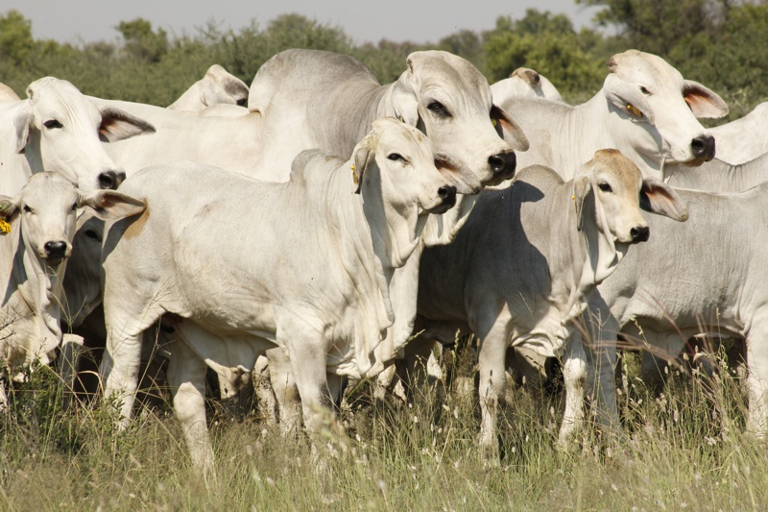
Beef cattle breeds in Zambia – The Brahman

Slide 13
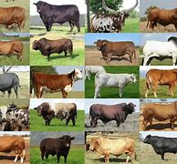
Beef Cattle Breeds in Zambia

Slide 14
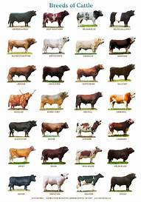

Slide 15
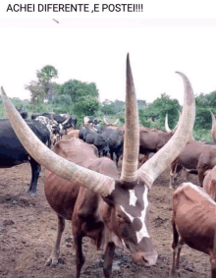
Stranger than Fiction

Slide 16
Dairy Cattle Breeds

